Slide 1
Healthy Digital Habits
Fall Semester Final Update
Developers
Cody Bergman, Isaac Eberhard, Trevor Lemert, Ethan Byers, Tyler Likens
Faculty Advisor
Dr. MD Romael Haque
Project Sponsors
Dr. Brandon McDaniel and Dr. Jessica Pater
Notes:
About Team profile, Overview of project / Problem statement, Expected deliverable system, Must complete requirements, Stretch goals, Challenges – Plan, Success factors, Risk lists and alternative solution

Slide 2
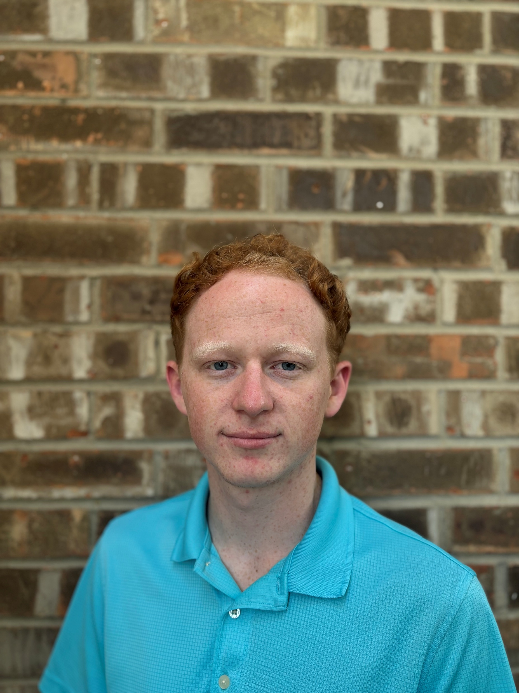
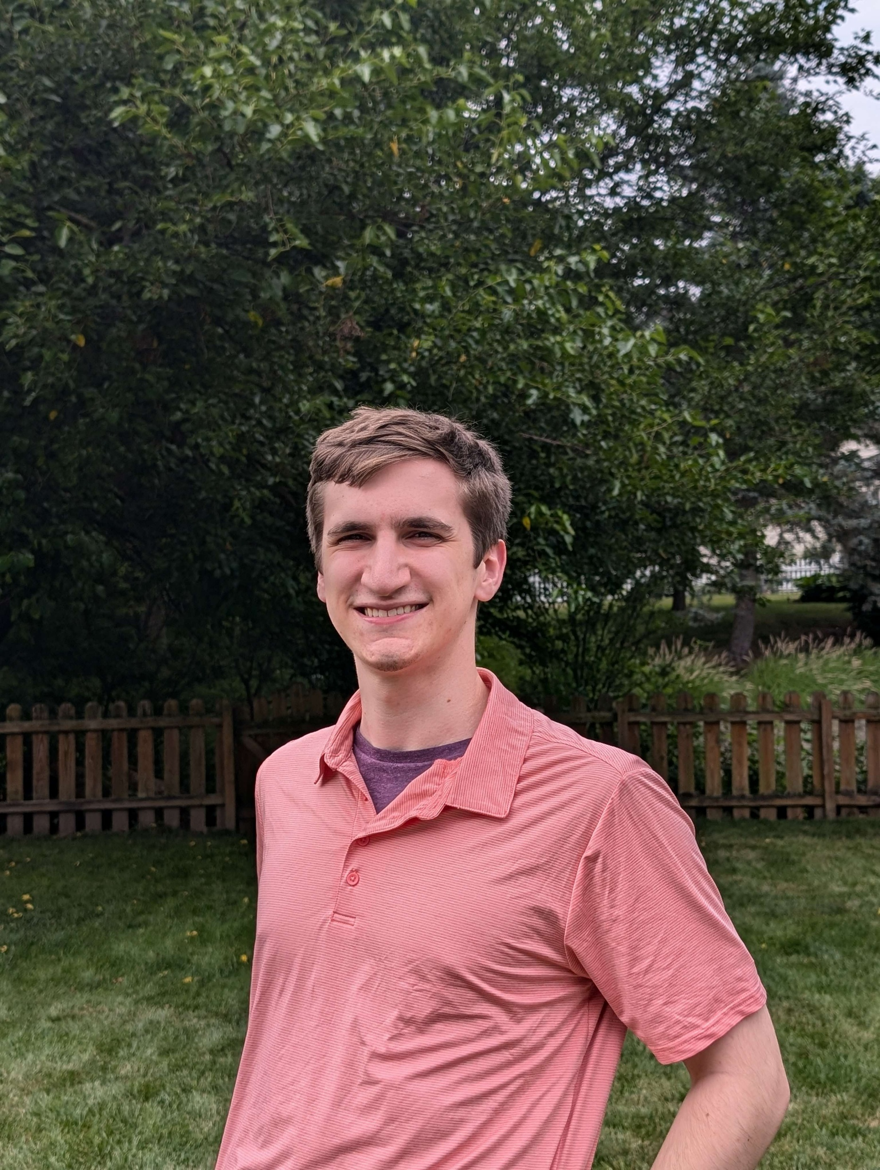
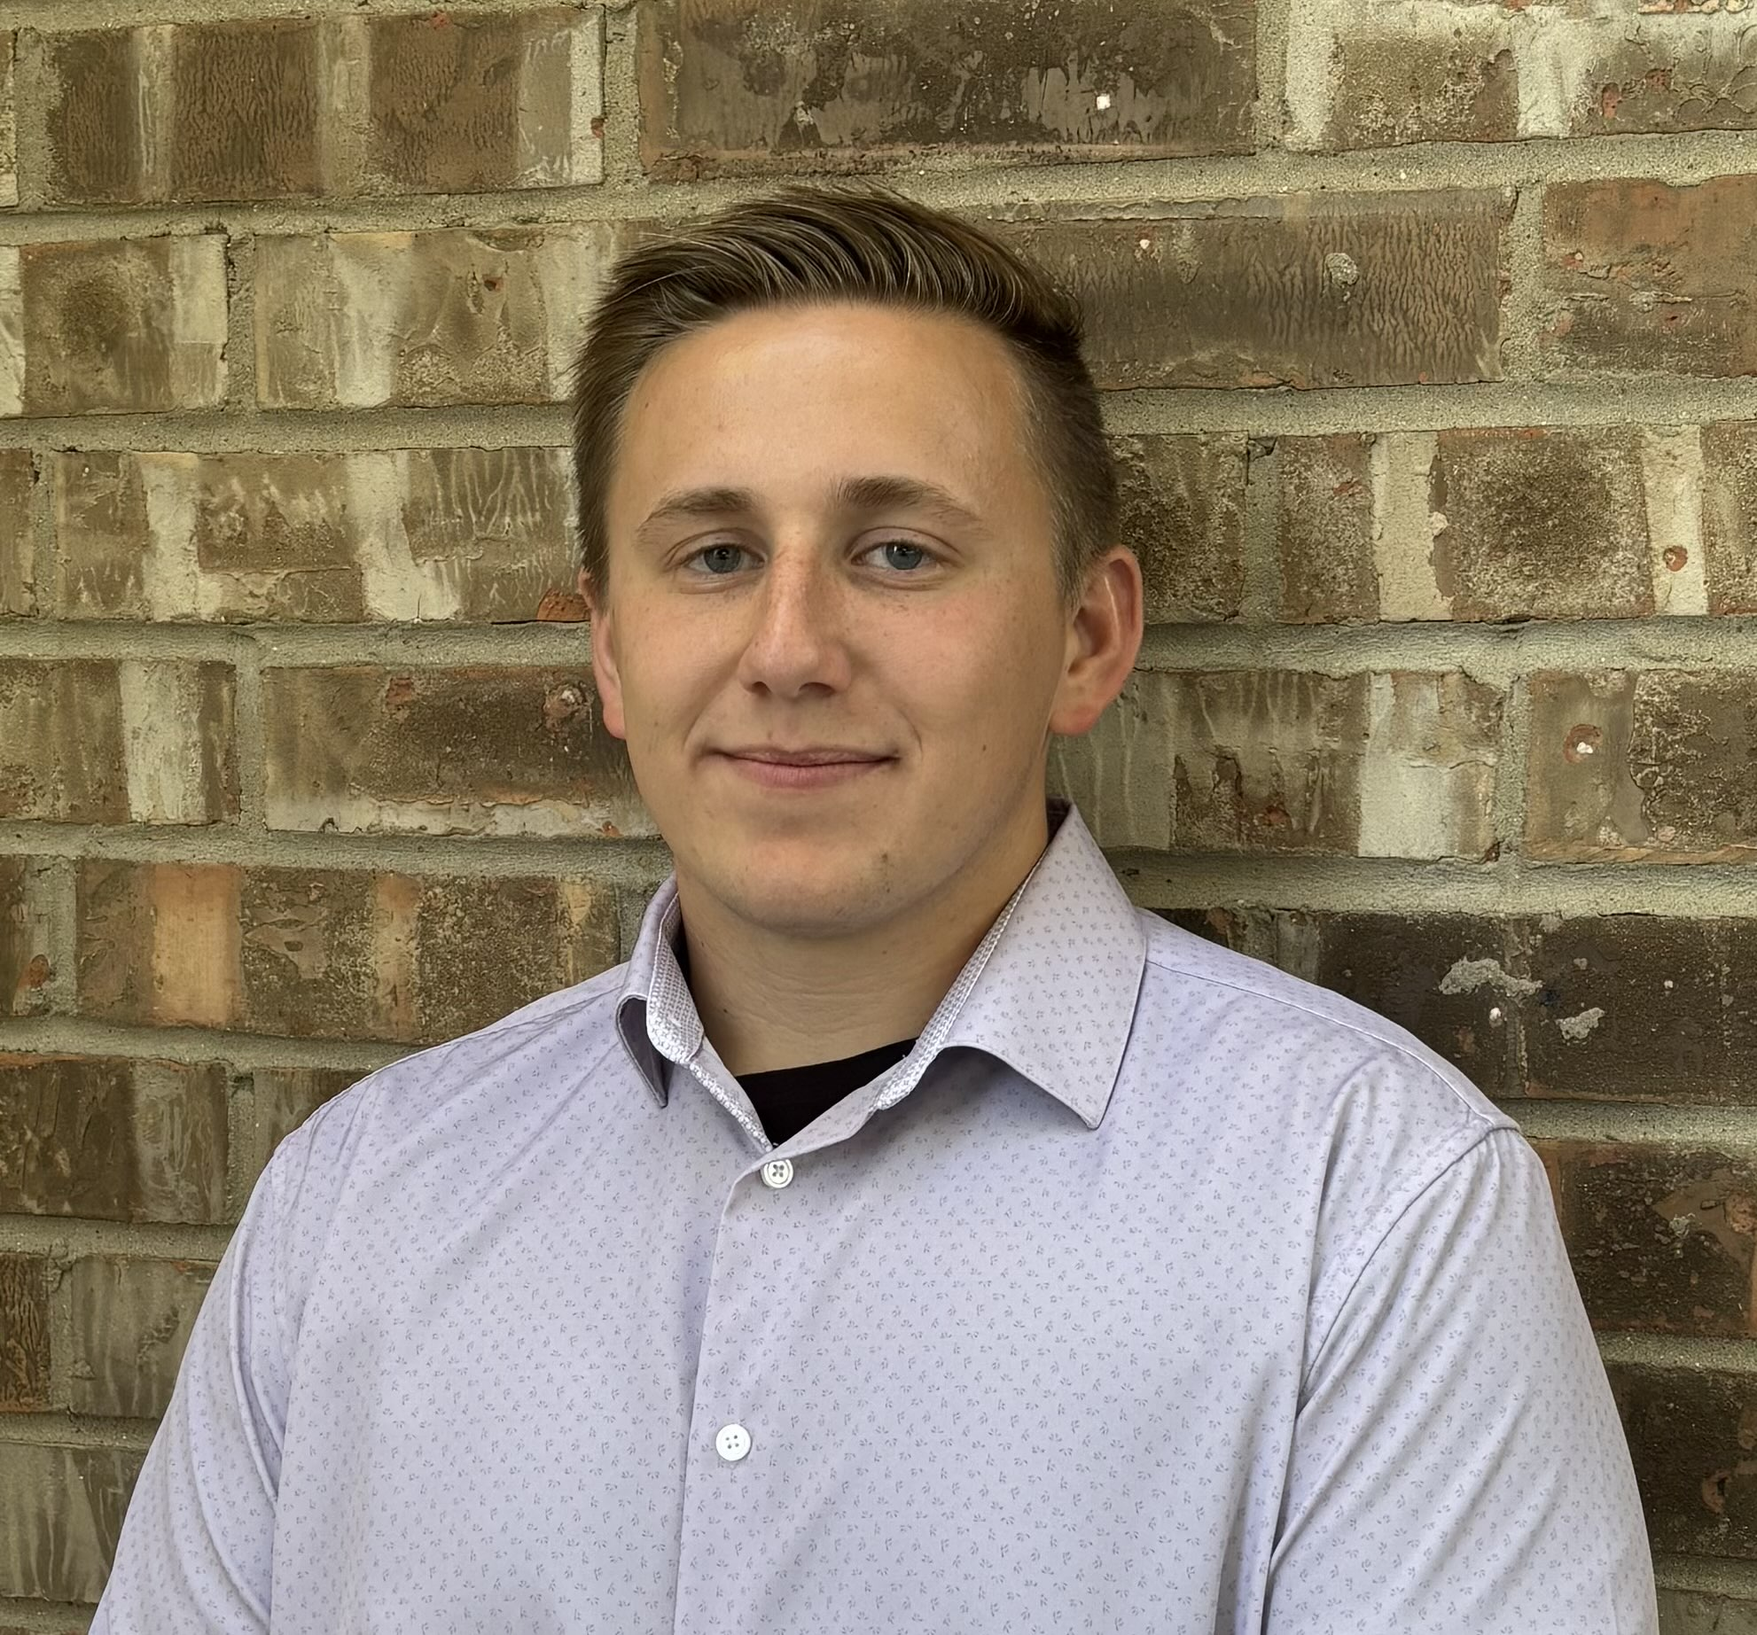
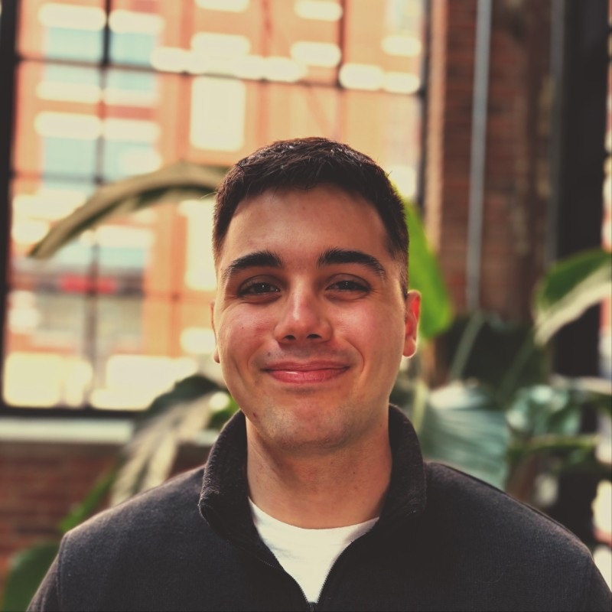

Meet the Team
Trevor Lemert
Backend / QA Tester
Ethan Byers
Front-end
Design / Development
Isaac Eberhard
Team Lead / Full Stack
Cody Bergman
Full stack / QA Tester
Tyler Likens
Full stack

Slide 3
Problem Statement
The Goal of the Project:
Develop a web application to help Parkview researchers better understand the relationship between smartphone use and family dynamics
Our Objective:
Implement missing functionality to give researchers the tools they need to create lesson plans
Overhaul UI for a more intuitive user experience

Slide 4
Project Background
Dr. Brandon McDaniel & team conducted study
Found that heavy smartphone usage negatively impacts household dynamics
Create a learning platform
Similar to online learning services like SkillShare and Coursera
Researchers collect feedback from clients (parents)
Lesson plans can be tailored to new developments
Teach healthier digital habits

Slide 5
Requirements
Functional
Admin view
Course creation tools (add, delete, edit, preview)
Support for various media types and content formats
Parent view
Ability to view on mobile device
Improved visuals and user feedback loops
Site wide
UI updates
V2 bug fixes
Non-Functional
WCAG 2.2 A Compliance
Mobile-friendly parent view
Bug fixes from V2
Scalable and ready for hosting (AWS, GCP, Azure)
Notes:
Segueway from priority change to requirements...requirements are the same....priorities have changed
Thought it would be cool to show progress.

Slide 6
Project Development Plan
Beginning Development
Here and Now
Parent UI Implementation
Pre-Initiation Stage
We plan to continue polishing course creation according to sponsor needs. Rest and recharge over break.
Final
Here we formed our team, met with Dr. McDaniel, Dr. Pater, and Dr. Haque.
We started simple, working on the navbar and other similar styling changes.
Continue implementing parent view changes such as the dashboard and improving the course viewing experience
Deploying the project, final documentation, back wrap-up
August
September
October
November
December
January
February
March
April
Inception, Elaboration, Prototyping
Project Deployment
Course Creation
Parent UI
Worked heavily on documentation and prototyping, receiving feedback from sponsors
In November, we reached a major milestone which was getting course creation working.
Provide high fidelity prototypes to serve as a NorthStar for our parent view UI improvements
Continued implementation, shortening the backlog. Preparing project for cloud deployment

Slide 7

Parent Use Case
Admin Use Case
Complete Daily Surveys
View Unlocked Courses
View/Complete Course Material
View Contents from Mobile Device
Provide Feedback
View/Complete Courses
Check individual data
Register/Login
Create Courses
Edit Existing Courses
Delete Courses
View Pooled User Data/Trends
Edit User Permissions
Delete User Accounts
Notes:
Shared functions first
Parent Functions
Admin Functions: We focused heavily on this side of things as this needed to be completed before we could complete changes to the user interface
Now hearing all these different things is great and all but lets take a look at the actual website.

Slide 8
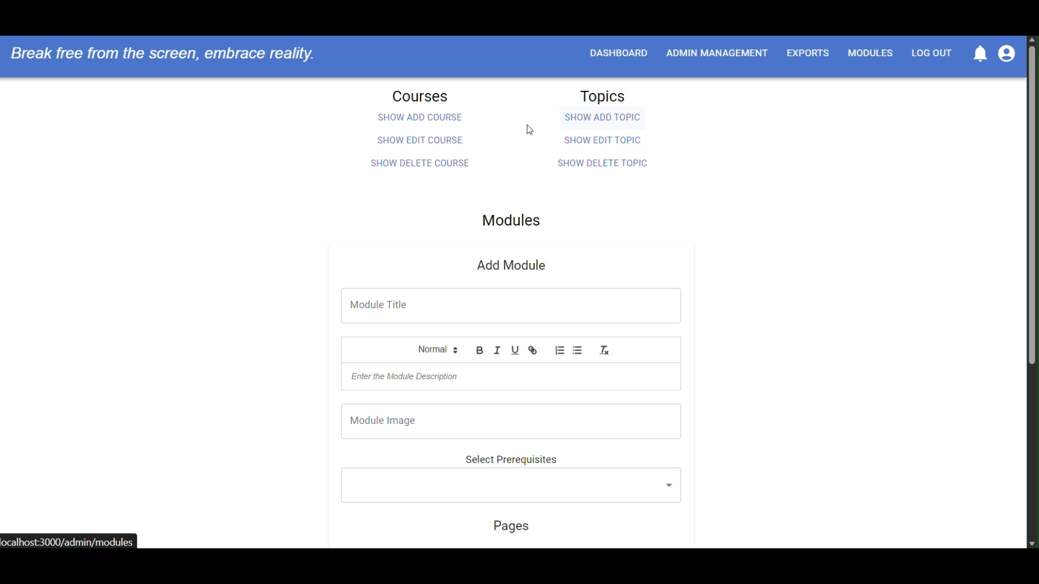
V2 Team Demonstration
Notes:
Here is a quick demonstration as to what the course creation page looks like from the previous team. The demo is showing how they would add a course, topic, and module. The major problem that we noticed with this was that it took a software developers understanding of the database to be able to create a full lesson. So, this is something that we have heavily updated to be more user friendly for the admins.
V2 Demo.mp4

Slide 9
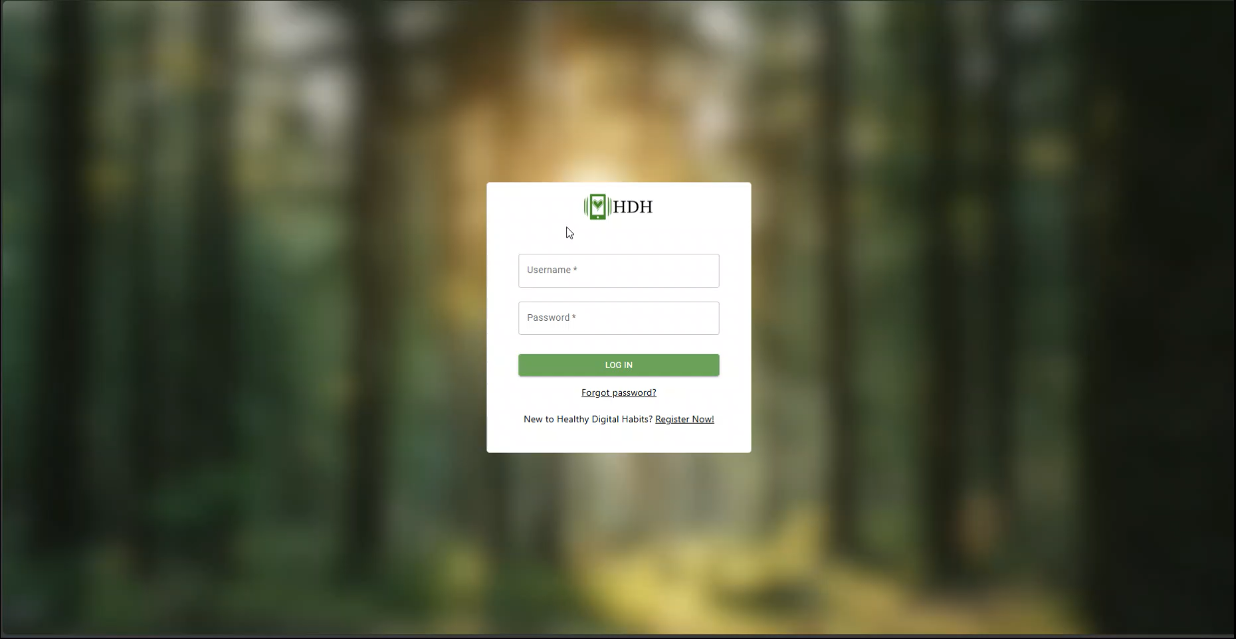
Demo
Notes:
Thank you, Trevor.
Now that we understand the problem we’re trying to solve and the requirements we’ve put in place, it’s important to look at how we’re actually implementing the solution.
This is our improved sign-in screen. Once we log in, we’re greeted with the Admin Dashboard. This view shows valuable information for our researchers, including user data and feedback. We plan to continue improving this dashboard in V2 next semester.
Next, we’ll move into the Admin Management screen. Here, you can see all previously created courses. For this demo, we’ll create a new one. I’ll call it Example V2, set the estimated completion time to 20 minutes, and paste an image URL. You can preview how the course card will look just by hovering over it.
We also have a hidden toggle, which determines whether users can see the course. This is especially helpful during development. Normally, you could click “Create and Go to Course,” but for now we’ll just create the course.
Once created, you’ll see the new course in the list, with options to edit, delete, or toggle visibility. If you click delete, you’ll get a confirmation modal.
Now let’s edit the course. We’ll create a couple of new topics—Example V2 and Example V3. After adding those topics, we can add a few modules. Adding a module automatically expands the topic it belongs to.
From here, you can move modules between topics, rearrange modules within a topic, or even reorder entire topics. All of this affects the order in which users experience the course.
When we select a module, we can rename it and choose a page layout. The current layout is top-middle-bottom, but you can also use layouts like left-middle-right. These determine how content is displayed to the user.
Let’s edit the top section. This is our rich-text editor, where you can enter a page title and description. Everything you enter here is stored as HTML and displayed directly to the user in the course. I’ll name this section “Top.”
For the bottom section, we’ll convert it into a question. We can enter the question text and add multiple answer choices. You can select one or more correct answers, delete choices, and enable dynamic branching. With branching, you can choose which page the user should go to based on their response.
We also support short-answer questions. Switching to short answer warns you about potential data loss, but then you simply provide the question prompt and an example answer. These responses are sent directly to researchers.
For this demo, I’ll switch the bottom section back to rich text and label it “Bottom,” just so you can see the layout clearly later.
Each module contains multiple pages. You can append a page to the end, insert a page anywhere, and delete pages with a confirmation prompt.
Finally, from the user’s perspective, we can open the newly created course. Once it loads, we can select the topic we edited and see exactly how that page layout appears to the end user.
20251209_204742.mp4

Slide 10
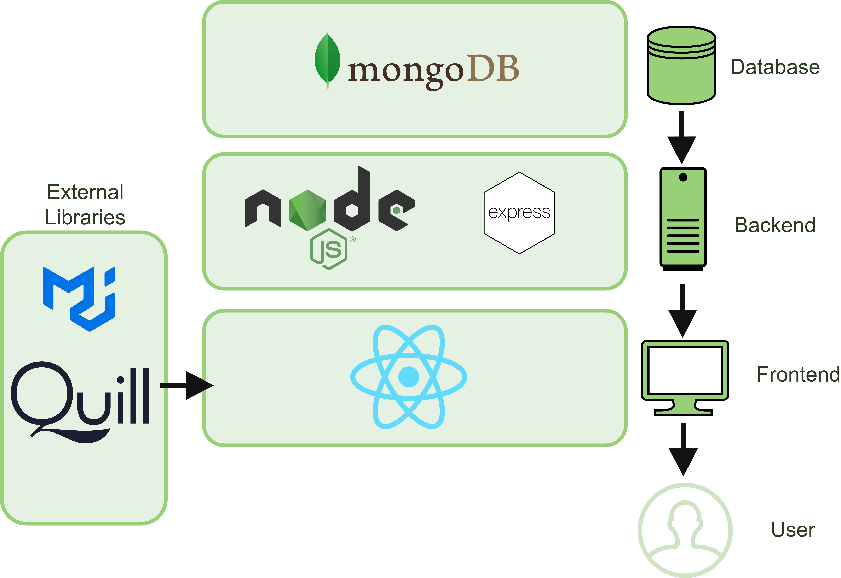
Technology Stack
Notes:
More on our tech stack that’s integrated into this project. From the last team that worked on this project, the tech that was already implemented was mongodb, react, express and node

Slide 11
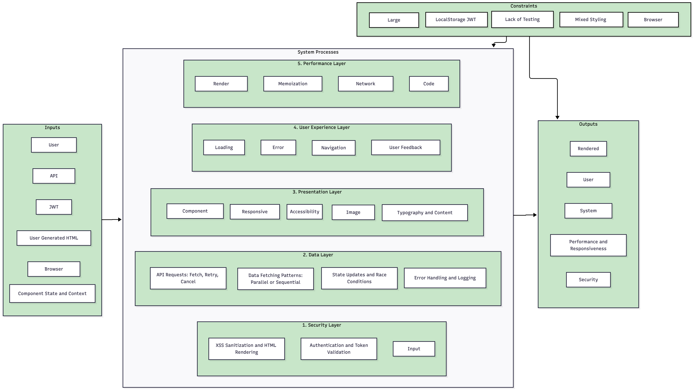
System Model
Notes:
Inputs: Materials and instructions arriving at the construction site.
Security Layer: The foundation that keeps the entire house structurally safe.
Data Layer: The plumbing and electrical that move resources reliably.
Presentation Layer: The walls and rooms the user actually interacts with.
UX Layer: The interior design that makes the space intuitive and pleasant.
Performance Layer: The insulation and efficiency that keep the house running smoothly.
Constraints: The building codes and weather conditions we must work around.
Outputs: The finished home delivered to the user.

Slide 12
Challenges
UI Continuity
Changing Stakeholder Requirements
Technical Challenges with Previous Code

Slide 13

Q&A

